Slide 1
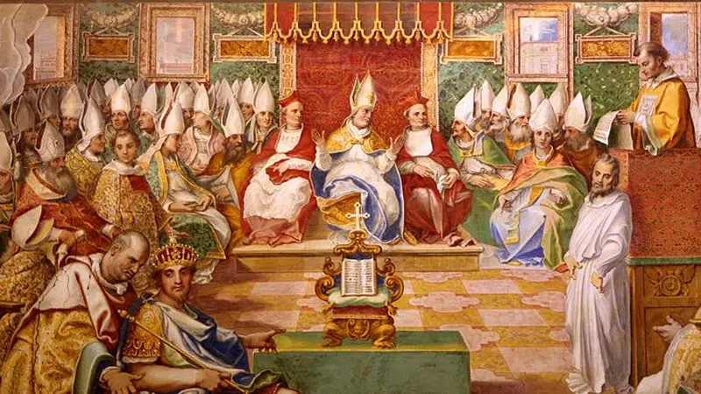

The Aftermath of Nicaea: 7 Crucial Transitions Following 325
D. A. Jacoby
Lancashire, UK

Slide 2
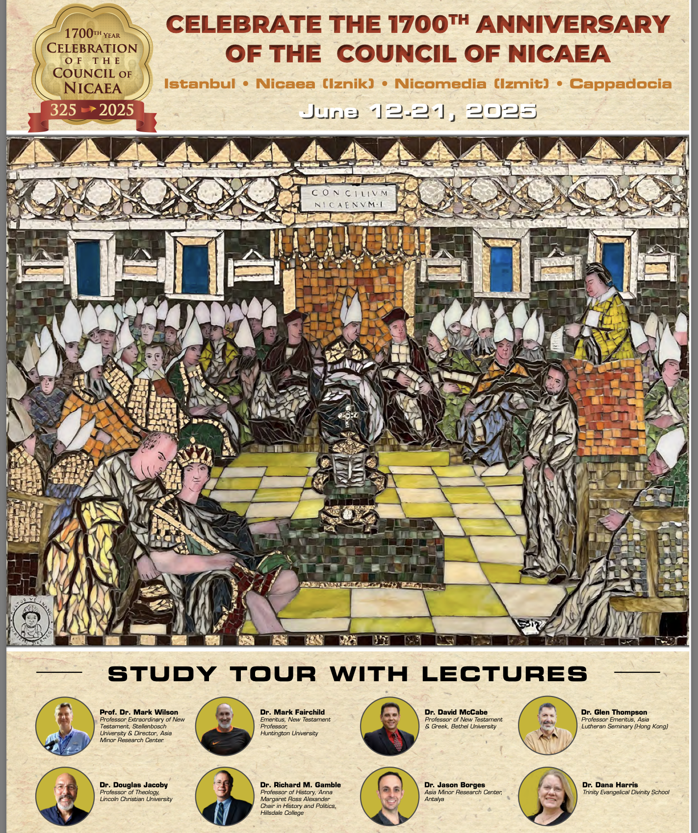
Our speakers:
Biblical scholars
Church historians

Slide 3
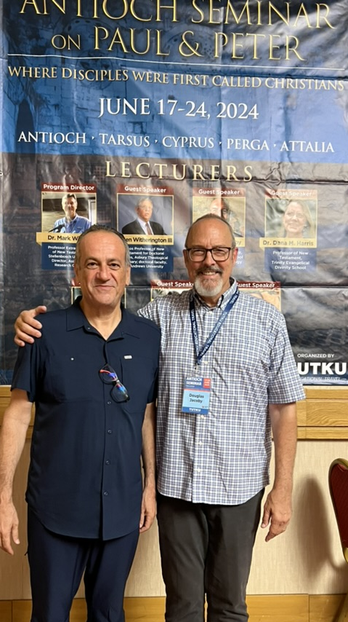

Slide 4
Aftermath
No event changed the nature of Christianity more than the Council of Nicaea. (Not the rise of the clergy, nor the monastic movement, nor even the Reformation!)
By “aftermath” I refer to the numerous changes enacted or enabled by this council and subsequent “ecumenical” councils—not necessarily immediate.
Some of my perspectives may seem unnecessarily strong, even unfair, although I’m striving to be evenhanded. Nor do I want to leave the impression that I see little value in councils, or reject the Creed. (I wish I’d been there!)

Slide 5
Imagine the energy!

Slide 6
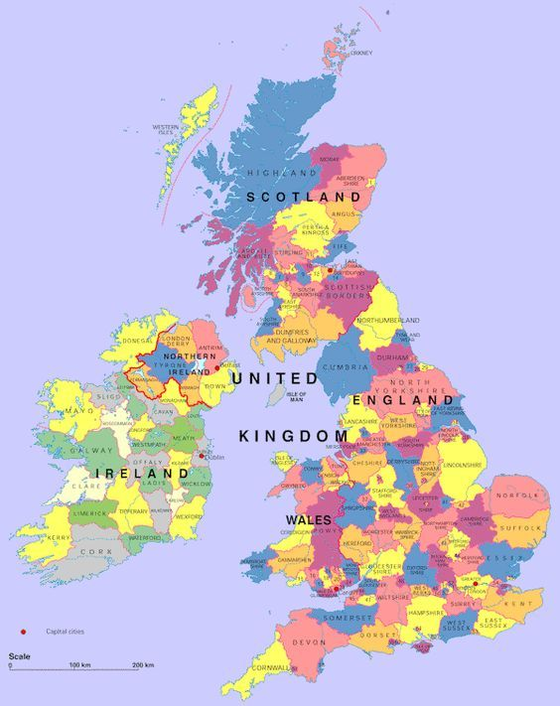
[Old] York
86 miles (138 km) east of our home

Slide 7
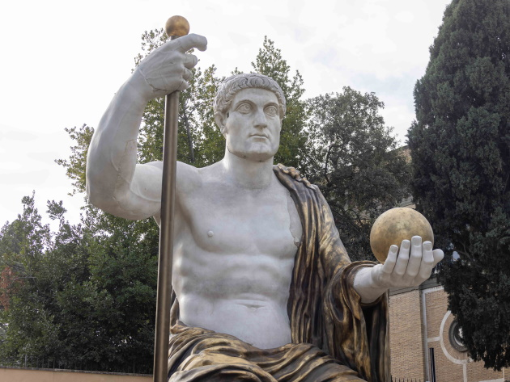
Constantine
Proclaimed emperor by the army
York, Northern England ad 306

Slide 8
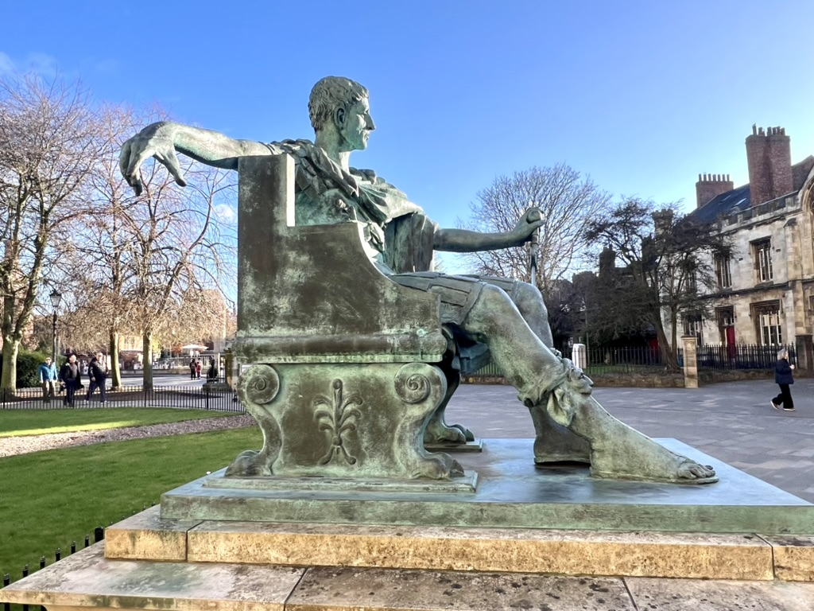
Constantine
Proclaimed emperor by the army
York, Northern England ad 306

Slide 9
1. Shibboleths & Labelling

Slide 10
שִׁבּוֹלֶת
… ⁴ Then Jephthah gathered all the men of Gilead and fought with Ephraim. And the men of Gilead struck Ephraim, because they said, “You are fugitives of Ephraim, you Gileadites, in the midst of Ephraim and Manasseh.”
⁵ And the Gileadites captured the fords of the Jordan against the Ephraimites. And when any of the fugitives of Ephraim said, “Let me go over,” the men of Gilead said to him, “Are you an Ephraimite?” When he said, “No,” ⁶ they said to him, “Then say Shibboleth,” and he said, “Sibboleth,” for he could not pronounce it right. Then they seized him and slaughtered him at the fords of the Jordan. At that time 42,000 of the Ephraimites fell (Judges 12:4-6).
שִׁבֹּ֜לֶת = ear of corn; flowing stream סִבֹּ֗לֶת = [ ]

Slide 11
1. Shibboleths & Labelling
Nicaea seems to originate the notion that fellowship—even salvation—depends on technical theology. A test of orthodoxy, hinging on a technical word not even found in scripture, homoousios.
“Ariomaniac.” Athanasius labeled “Arians” those not affirming the Creed exactly as worded. Jerome picked this up, too. Ulfilas labeled an Arian—but the Creed of Ulfilas is orthodox. And how likely is it anyway that the average Goth engaged in discussions about Arian doctrine—let alone grasped the subtleties?
But if church membership depends on opposition to the Arian position, I’m not sure how many members of our churches would still remain!
Application: terminology (pastor, quiet time), practices (music, NIV), opinions on non-biblical matters (Big Bang, politics).

Slide 12

2. Artificial Unity
Balance: Of ~1800 bishops invited, ~ 18% participated, most from the East.
Effectiveness: Pretense of Arian bishops. Nicaea hardly stamped out Arianism.
Seven (?) ecumenical (?) councils:
Two of four patriarchates rejected Ephesus. No one from Rome attended Constantinople (381). Chalcedon was not universally accepted. Parts of the West rejected the Seventh Council.
Besides, there were other councils traditionally not counted in the seven.
Catholics claim 21: 4th Constantinople, 1st-5th Lateran, 1st-2nd Lyons, Vienne, Constance, Florence, Trent, 1-2 Vatican.
Unity: Bitter rivalry amongst bishops of Antioch, Alexandria, Constantinople. Constantinople was above Alexandria. Rome wasn’t too happy, either. Constantinople (“New Rome”) wasn’t biblically connected.

Slide 13
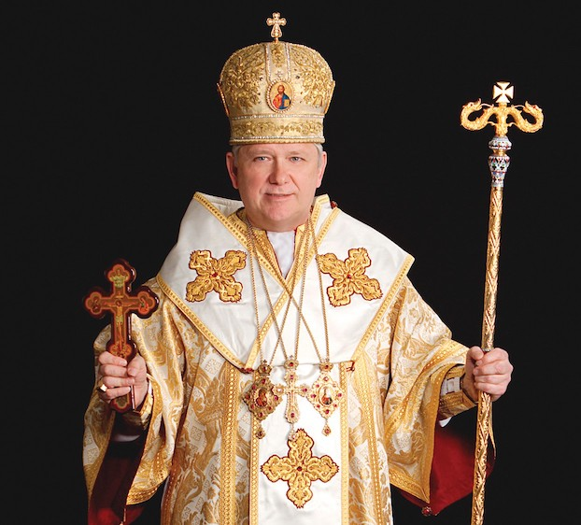
3. Hierarchies & Honorific Titles
The apostles set up no elaborate leadership structure.
Presumably Jesus would have said something about this.

Slide 14
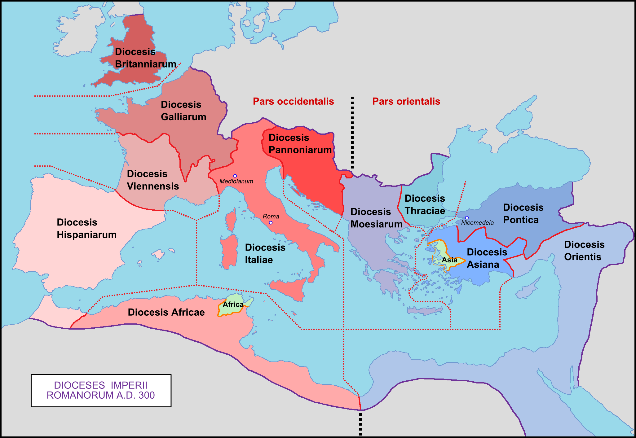

Slide 15
3. Hierarchies & Honorific Titles
The apostles set up no elaborate leadership structure.
Presumably Jesus would have said something about this.
Canons 4, 6, 15 – appointments and control. Canon 7 specifies the most important patriarchates (putting down Antioch). Canon 18 specifies special seating and special titles.
Eastern Orthodox, Ethiopian Orthodox, and Byzantine Catholicism speak of Constantine the Great as “equal to the apostles.”
Didn’t Jesus forbid honorific titles (Matthew 23:8-10)?

Slide 16

4. Lack of Grace
Canons 11, 12, 14 – the doghouse for the fallen (12y), those returning to the military (13y), and lapsed catechumens (3y).
2nd and 3rd C. church discipline harsher and harsher. But now penalties are enshrined and presented as harmonious with apostolic teaching.
Not to say the church always embraced hardline positions—unlike some heretical groups.
Interest in proving oneself right, discrediting the other, instead of real dialogue. Forcing agendas (as at Ephesus).

Slide 17
4. Lack of Grace
The effects of that envious spirit which so troubled the peace of the churches of God in Alexandria, together with the schism in Thebes and Egypt, continued to greatly disturb [Constantine]. For in fact, in every city bishops were engaged in obstinate conflict with other bishops, and one group of people rising against another, coming into violent collision with each other almost like the fabled Clashing Rocks.
Eusebius of Caesarea, Life of Constantine 3.4-24

Slide 18
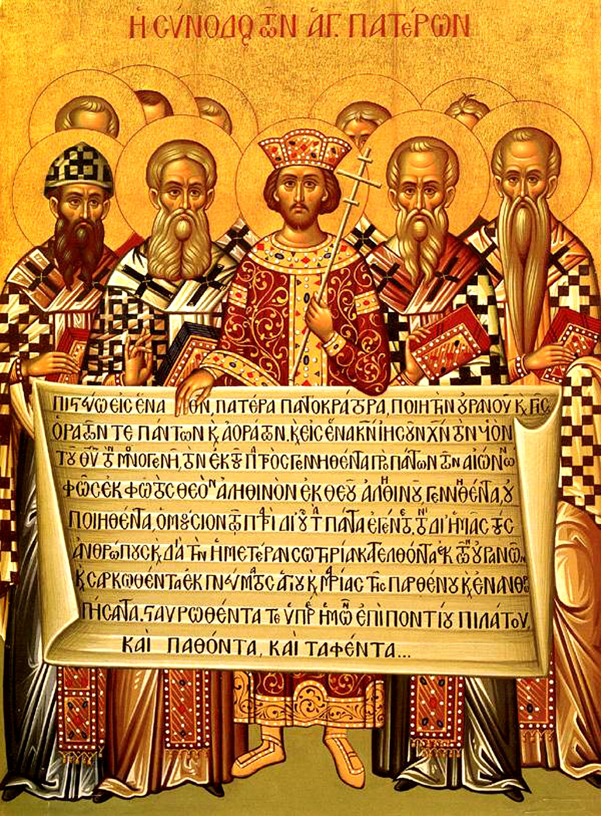
5. Going (well) Beyond Apostolic Teaching
“The faith once for all delivered to the saints” (Jude 3): apostles or Councils? Was Gregory of Nazianzus right? John 14; 16?
Was the Apostles’ Creed defective? Not at all—as a baptismal catechetical document. Yet requiring affirmation of creeds, however well-intended as instruments of unity, easily backfires.
The Council of Acts 15 exhibited a different spirit. It was also attended by apostles. The council did not add to the terms of Christian discipleship.
Councils are not infallible (contra Timothy [Kallistos] Ware). They claim to preserve the pristine doctrine, but they do not. On Trinity and salvation they’re solid, but much goes beyond and even contradicts Jesus’ teaching.
What authority does the World Council of Churches possess?

Slide 19
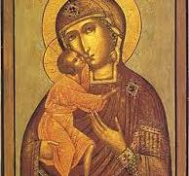
6. Selective Interpretation (and Memory)
Example: Icons (754 vs. 787): “He who worships the image worships the one pictured in it… Anathema to those who do not salute the sacred images, or who call them idols.”
Early Christians weren’t opposed to iconic art! Nor were early Muslims, three centuries later—based on numismatic evidence. But use of icons as worship aids is quite a different matter than Christian art.
Synod of Elvira (305 or 306): Canon 36: “There shall be no pictures in churches, lest they worship what is depicted on walls…”
The Council of Frankfurt (794) declares the Seventh Council null and void, because it overthrew the Council of Hieria (754). Condemned iconodules and iconoclasts: images can still be useful educational devices. Iconoclasm dominates the East 814-843, before the final “Triumph of Orthodoxy.”
Irony: creeds aren’t meant to be added to, but that’s exactly what happened in 381.

Slide 20
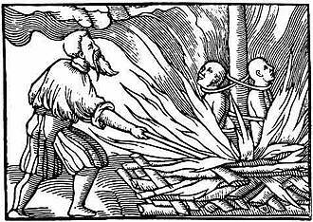
7. The Embrace of Coercion

Slide 21
7. The Embrace of Coercion
The emperor decreed that those who refused to endorse the creed be exiled. Arius, Theonas, and Secundus were exiled to Illyria, in addition to being excommunicated.
Death for even possessing the writings of Arius. Constantine ruled, and as far as I know none of the Christian leaders present objected. Hyperbolic language, like war rapportage in the OT? Or like the capital punishment legislation of the OT, seldom if ever carried out?
Constantine exiled few bishops, and only after they were condemned by councils; his son Constantius I did so much more freely and without conciliar approval, starting a new trend.

Slide 22
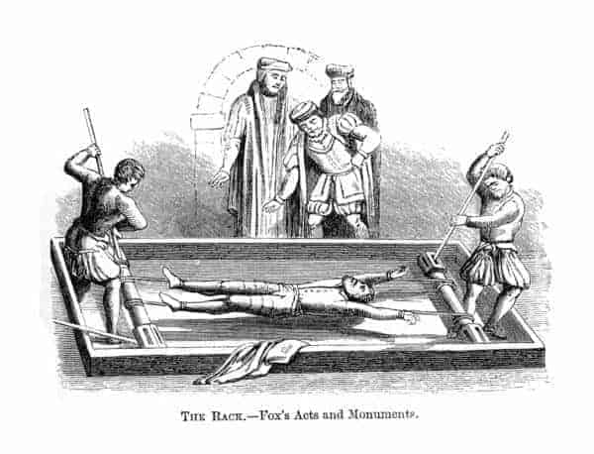
Multiple precedents were set:
State power
Bullying
Book burning
Torture & execution
Exile

Slide 23
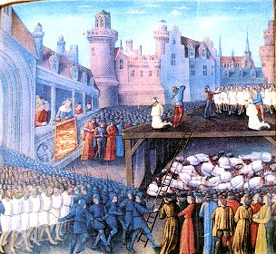
Multiple precedents were set:
State power
Bullying
Book burning
Torture & execution
Exile
Overlooking the immorality of leaders
Emperors who murdered others were permitted in the church. Constantine killed his son Crispus in 326, long after he had sided with Christianity. That year he also killed second wife, Fausta. (No recrimination?) And yet he was canonised by the 7th C!
Bishops denounced rulers if heretical; if immoral, less likely.

Slide 24
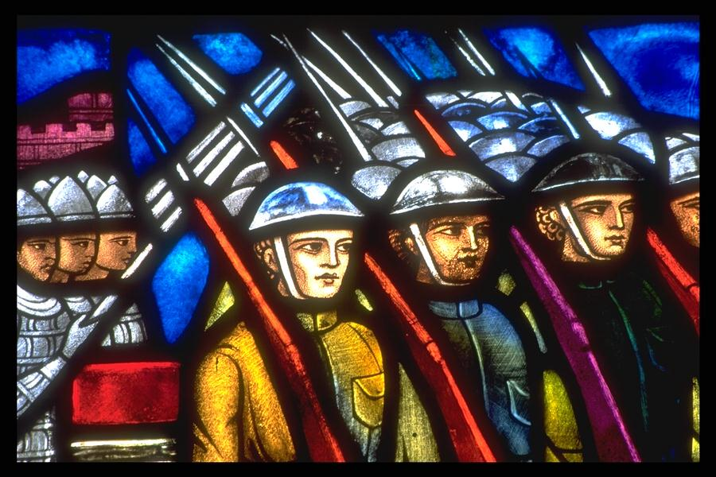
Multiple precedents were set:
State power
Bullying
Book burning
Torture & execution
Exile
Overlooking the immorality of leaders.
Emperors who murdered others were permitted in the church. Constantine killed his son Crispus in 326, long after he had sided with Christianity. That year he also killed second wife, Fausta. (No recrimination?) And yet he was canonised by the 7th C!
Bishops denounced rulers if heretical; if immoral, less likely.
In the E, the whole church had become subservient to the state. The W wasn’t far behind.

Slide 25
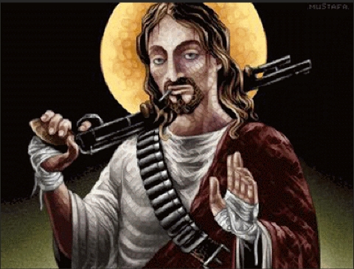
Multiple precedents were set:
State power
Bullying
Book burning
Torture & execution
Exile
Overlooking the immorality of leaders.
Emperors who murdered others were permitted in the church. Constantine killed his son Crispus in 326, long after he had sided with Christianity. That year he also killed second wife, Fausta. (No recrimination?) And yet he was canonised by the 7th C!
Bishops denounced rulers if heretical; if immoral, less likely.
In the E, the whole church had become subservient to the state. The W wasn’t far behind.
Evangelical shift towards violence (esp. since the 1970s). Du Mez, Jesus and John Wayne.

Slide 26

Religious freedom

Slide 27
Religious freedom
Tertullian: Christians were the first group in the ancient world to introduce the concept of religious freedom. Free to choose, without state coercion. “Religious faith is an inward disposition of the mind and heart and for that reason cannot be coerced by external force.”
“It is only just and a privilege inherent in human nature that every person should be able to worship according to his own conviction… It is not part of religion to coerce religious practice.”
We could also consider Lactantius, whom Constantine chose to tutor his sons, as a second proponent of religious freedom (for pagans as well as Christians]. The boys didn’t get the message, apparently.
Although episcopal elections were normally peaceful, still armed riots sometimes took place over elections of bishops. I refer esp. to the 400s.
Consider also the persecution of pagans, Jews, and heterodox Christians.

Slide 28
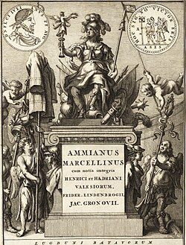
“No wild beasts are such enemies to mankind as are most Christians in their deadly hatred of one another.”
Ammianus Marcellinus, c.330-400

Slide 29
Review
Shibboleths & labelling
Artificial unity
Hierarchies & honorific titles
Lack of grace
Going beyond apostolic teaching
Selective interpretation & memory
The embrace of coercion

Slide 30
Closing Thoughts
There was no real difference between the visible and invisible church in 125. Fast-forward 200 years. In the aftermath of 325, the difference was enormous!
Rome, no longer “antichrist,” was now the servant of God and engine of the kingdom.
Roman emperors called the 7 officially ecumenical councils.
The church will soon be thoroughly married to the state.
Many refused to accept the state church as the true church of Christ.
It’s a fatal cocktail of church and politics, as proven by subsequent history.
Had we lived through this period, or attended the council, would we have got it right? (Hindsight is a wonderful thing.)
As for Nicene orthodoxy, many even today misunderstand the Council. “The council rejected Arius’s teaching about the subordination of the Son to the Father” (BAR Spring 2025, vol.51, no.1, p.24, “The First Council of Nicaea”). This is only partly true. Subordination in rank (order) doesn’t mean Jesus is less divine (inferior in nature). [See me for a handout.]
Read the pre-Nicene literature! You’ll find no dioceses, fancy titles, icons, incense…But you may find inspiration, wisdom, and fellowship.

Slide 31
The Aftermath of Nicaea: 7 Crucial Transitions Following 325
D. A. Jacoby
Lancashire, UK

